Slide 1
International Debt Statistics
A Detailed Project Report.
Umesh Pawar

Slide 2
PROJECT DETAILS
Project Title : Analyze International Debt Statistics.
Technology : Business Intelligence.
Domain : Finance.
Project Difficulty level : Intermediate.
Programming Language Used : Python
Tools Used : Jupyter Notebook, MS-Excel, Power BI.

Slide 3
Objective :
The goal of this project is
to analyze international debt data collected by The World Bank.

Slide 4
Problem Statement
It's not that we humans only take debts to manage our necessities. A country may also take debt to manage its economy. For example, infrastructure spending is one costly ingredient required for a country's citizens to lead comfortable lives. The World Bank is the organization that provides debt to countries.
In this project, you are going to analyze international debt data collected by The World Bank. The dataset contains information about the amount of debt (in USD) owed by developing countries across several categories. You are going to find the answers to questions like:
• What is the total amount of debt that is owed by the countries listed in the dataset?
• Which country owns the maximum amount of debt and what does that amount look like?
• What is the average amount of debt owed by countries across different debt indicators?

Slide 5

Architecture

Slide 6
Why parameters are important
Our analysis is done based on dataset provided for different 123 countries and 563 indicators. The analysis is done debt and year wise.
1. Country Name–There are total 138 country’s name. Some of them are
a. Afghanistan
b. Bhutan
c. Egypt
d. India
2. From 1st to 6th Columns country name, country code,
Counterpart-Area Name Counterpart-Area Code Series Name Series Code
3. is mentioned and then rest in 59 columns from 1970 to 2028 historic data of debt are mentioned.

Slide 7
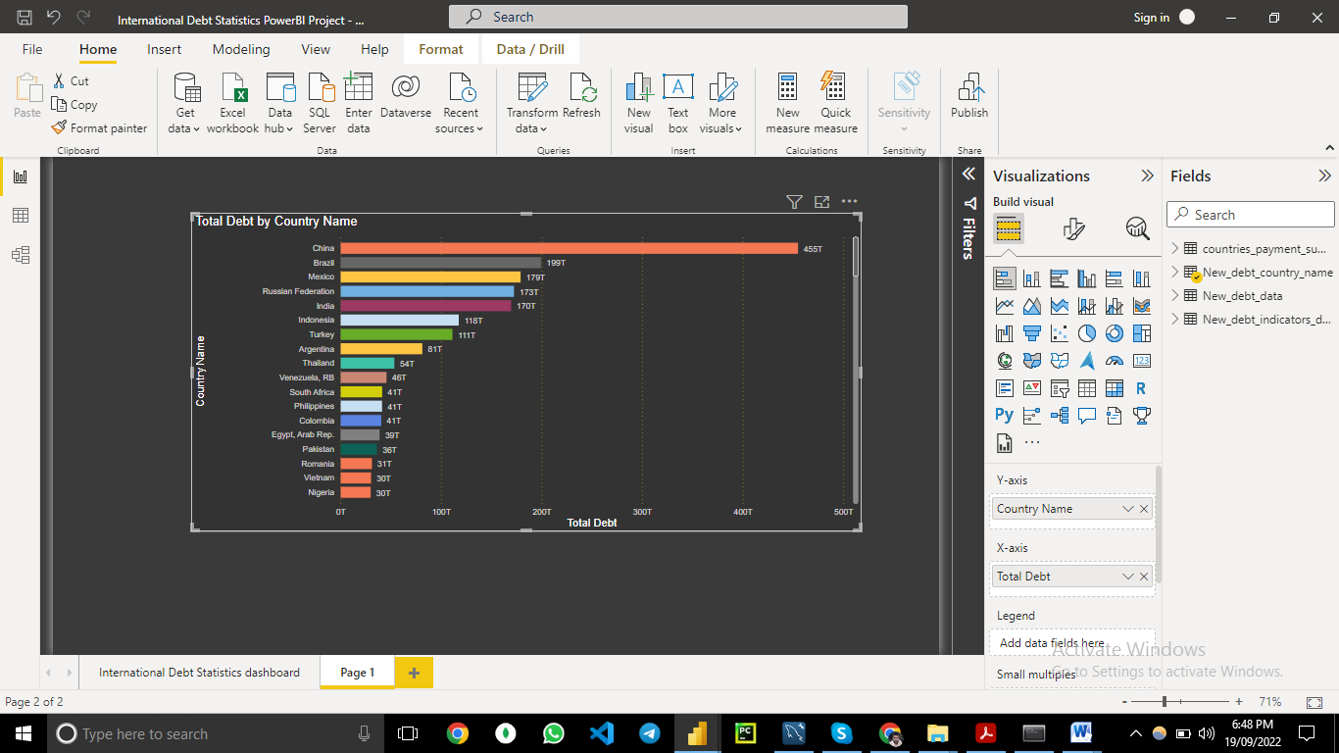
Total debt By country name

Slide 8
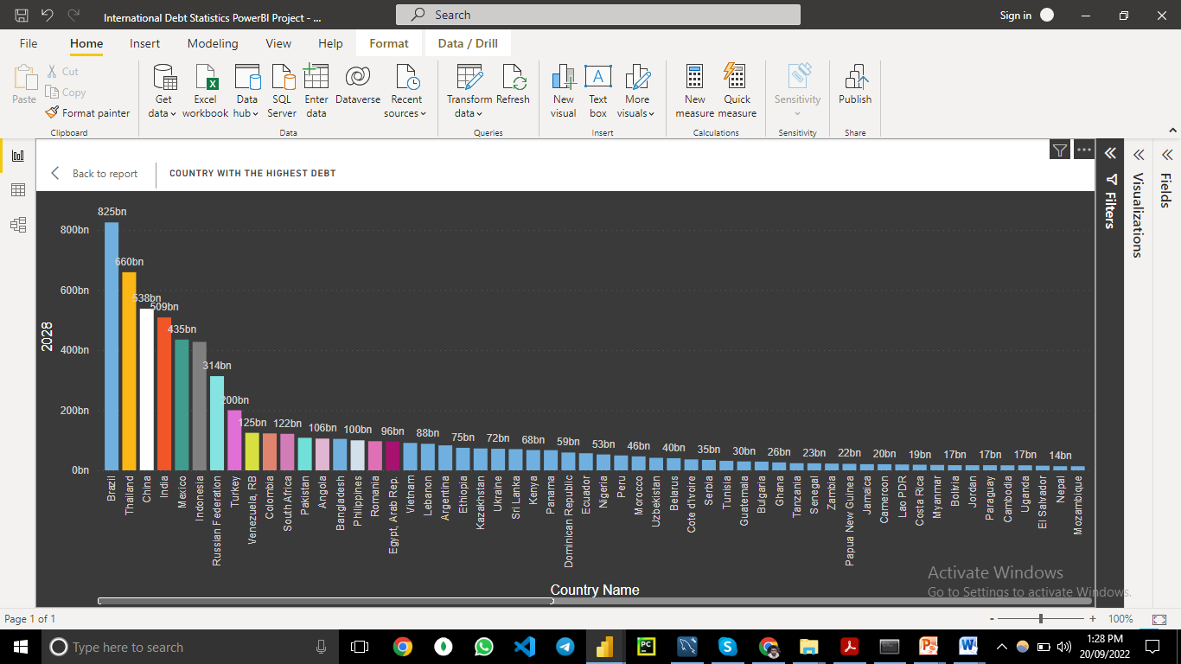
Country with highest debt

Slide 9
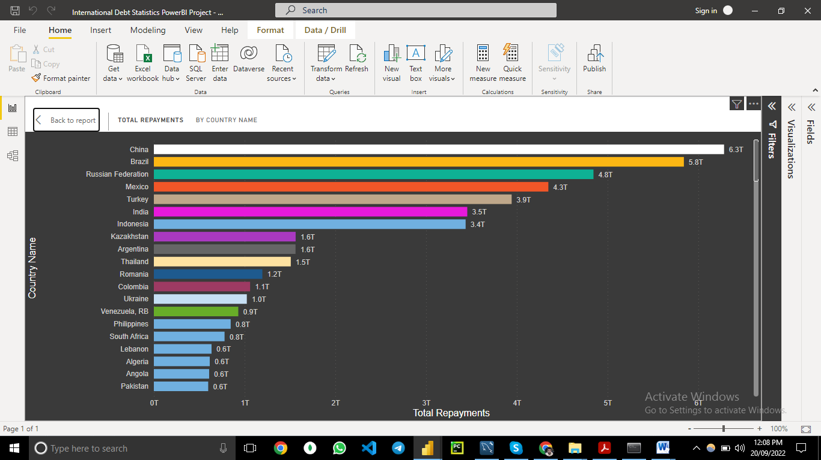
Total Repayment

Slide 10
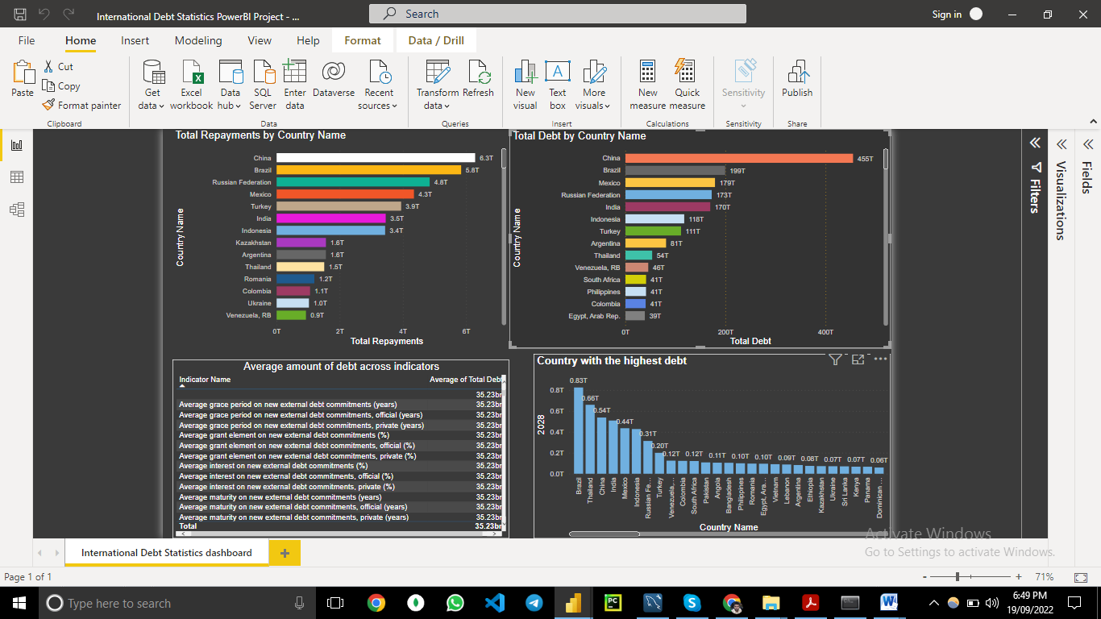
International debt Statistics Dashboard

Slide 11
Thank you

